Slide 1

IAIA Project 2024
IAIA Project #2
Gomoku & Checker Game Automation
Using UR5e Robot Arm – Hardware Implementation
School of Mechnical & Control Engineering Industrial AI and Automation
Kwak, Jin(21900031)
Lim, Soonho(21900610)
An, Gyeonheal(21900416)
Han, Taegeon(21900793)
Prof. Young-Keun Kim
2024.11.15

Slide 2
Contents
Background
Goal of the Project
Flowchart
Expected Outcome
Schedule

Slide 3
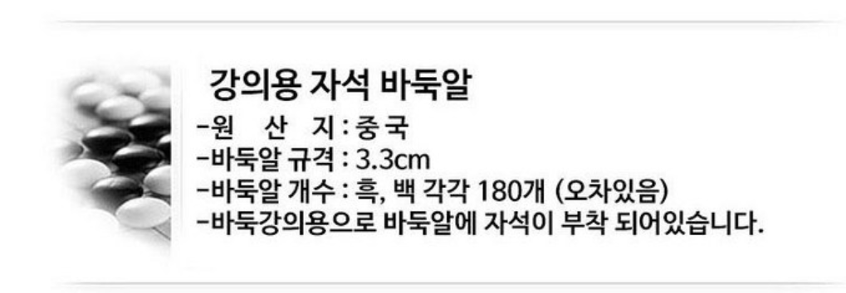
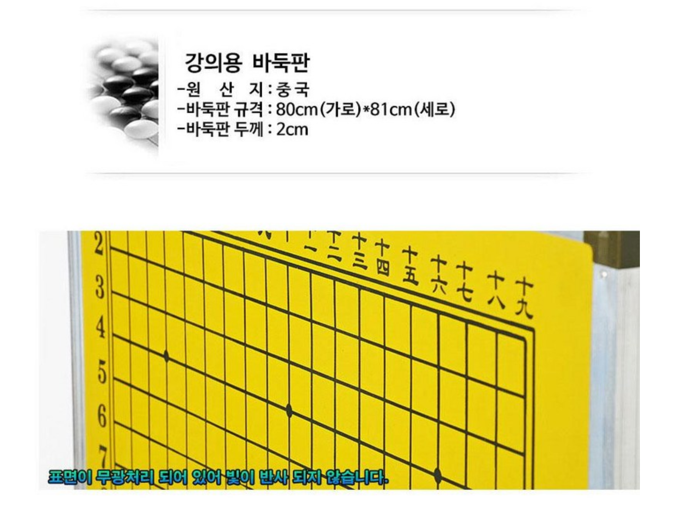
1. Components List
1. Gomoku Components
2. Checker Components
3. Optic Table
4. Camera

Slide 4
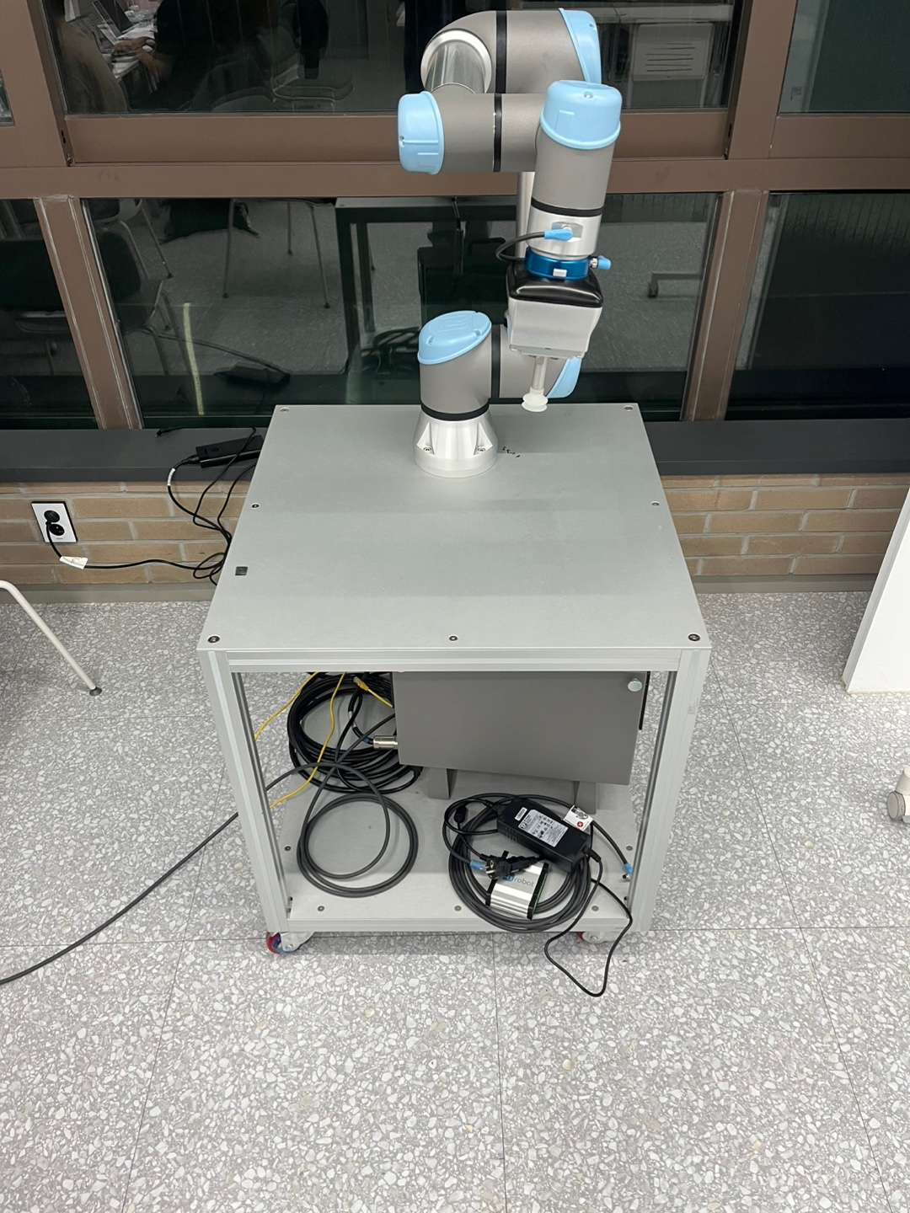
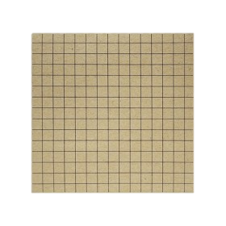
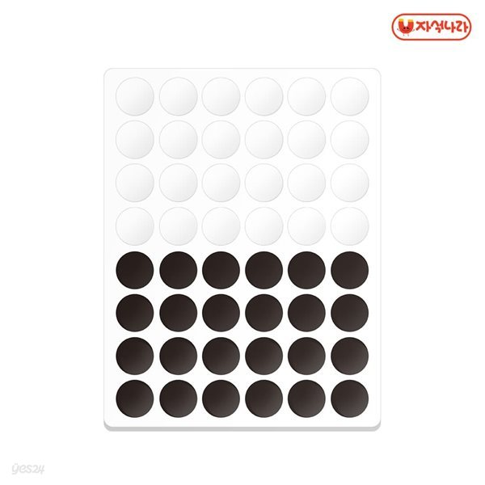

2. Components Settings
R
Components Setting Image
Top View

Slide 5
Robot Movement Flowchart

Slide 7
2. Goal of the Project
Goal of the Project
Enhance the Gomoku playing experience by using *UR5e robot arm
Create user-friendly system for convenient and seamless operation
Specific goals
Apply reinforcement learning (*DP) for Gomoku strategy
Detect user’s stone position via image processing
Use *UR5e robot arm to place stones optimally
Recognize user face for game records with PyTorch-based *DL
*DP – dynamic programming
*DL – deep learning
*UR5e – robot arm model
Notes:
The main goal of our project is to develop a machine learning-based model to detect coil defects in hot-air drying process equipment. Additionally, we aim to predict the Remaining Useful Life (RUL) of the equipment to proactively address potential failures.
Specifically, we want to achieve a detection accuracy of over 90% for identifying defects and ensure that 80% of our RUL predictions fall within an acceptable margin of error after our model is trained and tested. This will not only help us prevent coil-related failures but also ensure better equipment management and productivity.

Slide 8
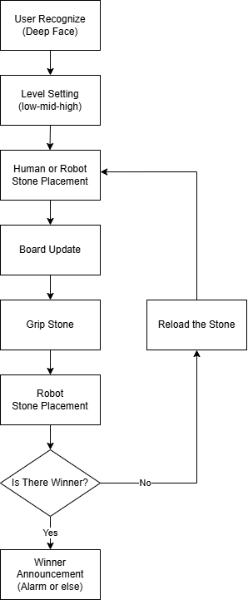
3. Flowchart
Recognize User Face
Deep learning (Deep Face)
Load history records
Set Level
Automatically or Manually
First mover selection (random or manual)
Board Update
Detect newly placed stone, image processing (OpenCV)
Determine the turn of the current player
Grip Stone
Grip pre-positioned stone
Robot Stone Placement
Retrieve the required location from DP algorithm
Place the stone to specific coordinate
Verify End
Check for the five continuous stone
Winner Announcement
Give the result of the play
If not repeat step(3~6)

Slide 9
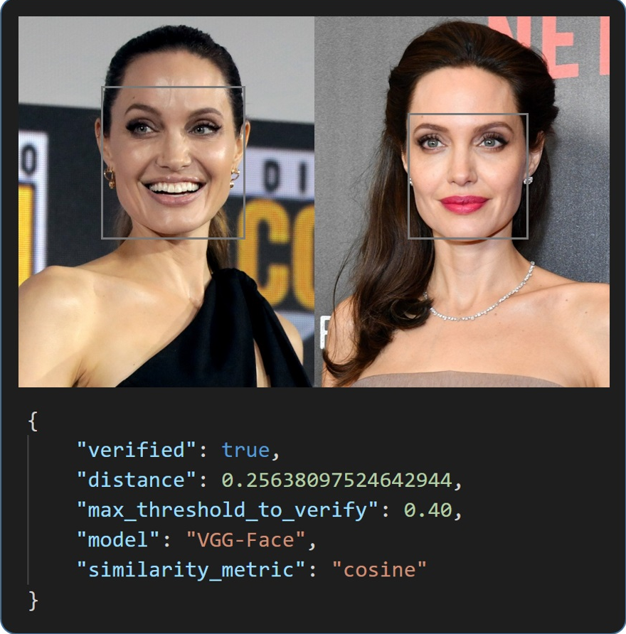

3. Flowchart
Data storage
Deep Face Module
Login or create the account using face recognition
Load the match history
Level Setting
Robot predicts N steps ahead, so change N or weight
Planning to make user friendly GUI

Slide 10
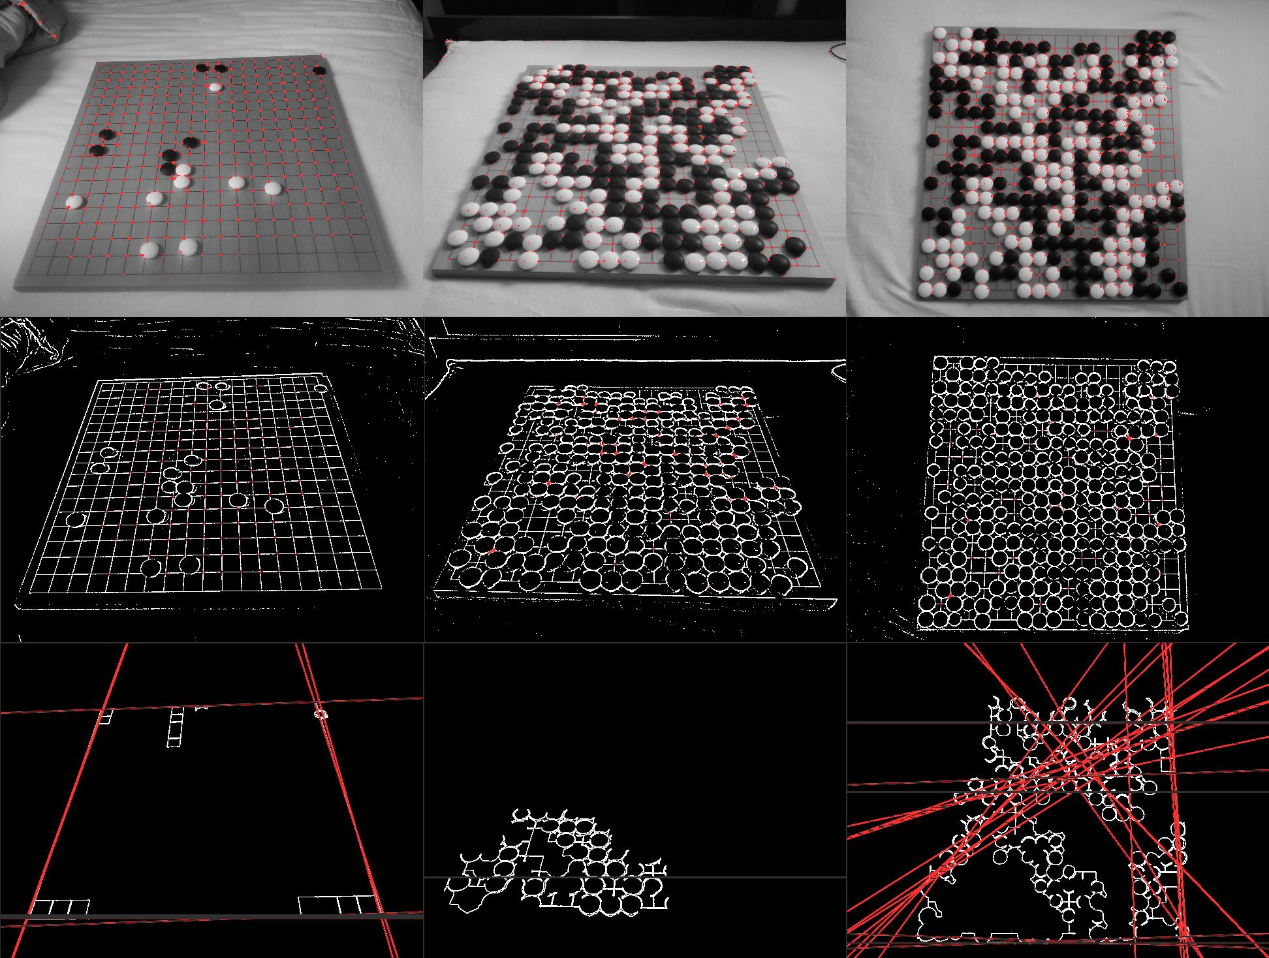
3. Flowchart
Board Update
Update the board status using image processing (OpenCV)
* If there’s much disturbance, uses Deep Learning

Slide 11
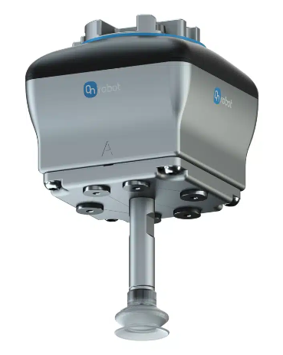
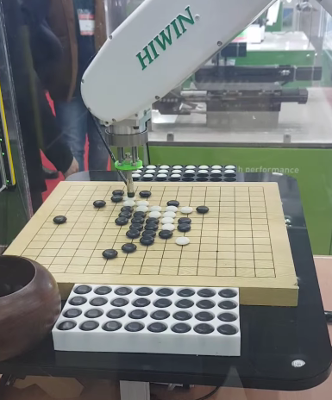
3. Flowchart
Grip Stone
Grip the stone using vacuum gripper
Stone Placement

Slide 12
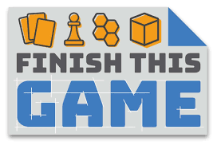
3. Flowchart
Verify winner and announcement
Announce the winner by music or robot movement

Slide 13
5. Schedule
Task |  | week11 |  | week12 |  | week13 |  | week14 |  | week15 |  | week16
ALL | Reinforcement learning study
An | Research on DL model
 | Develop DL model for face recognition
Han | Build user record system(Database)
 | Adapt difficulty level on different records
Kwak | Gomoku implementation using RL
 | Position update algorithm
Lim | Set up coordinates for precise position
 | Develop the whole system (GUI)
An: Gyeonhil An
Kwak: Jin Kwak
Han: Taegun Han
Lim: Soonho Lim

